Slide 1





HOME CREDIT LOAN RISK Group 5
Athulya Anand Shubham Patil Sricharraan Ramaswamy Varsha R
2000923101 2000938033 2000855651 2000751388
athanand@iu.edu shupatil@iu.edu sriramas@iu.edu varavi@iu.edu

Slide 2
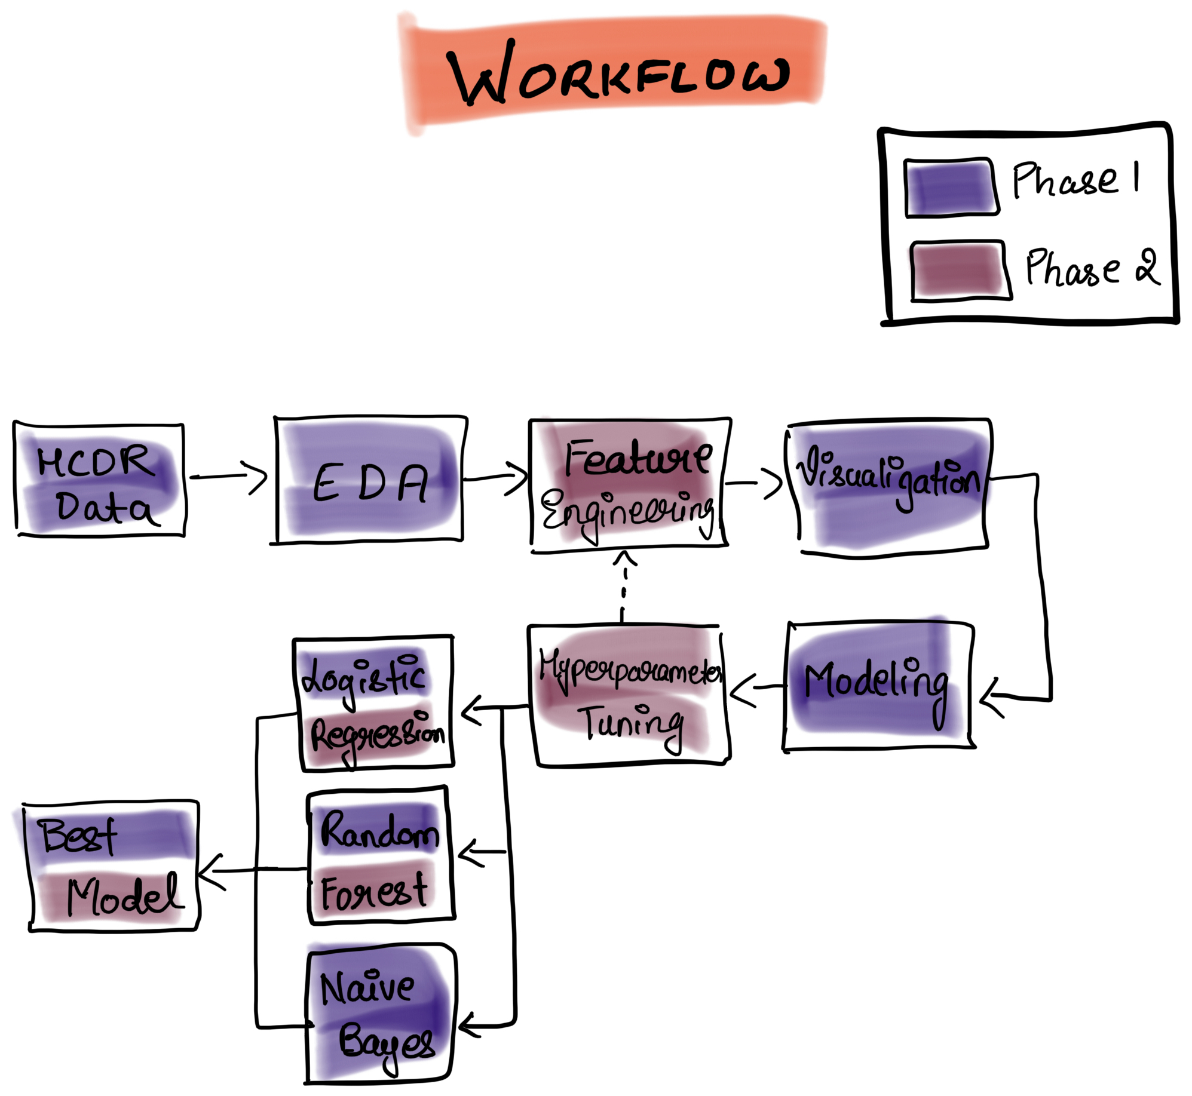
Outlines and Tasks
Project Description: Phase 2
Phase 2 Workflow
Baseline Modeling
Logitic Regression
Random Forest Classifier
Metrics
Feature Engineering
Hyperparameter Tuning
Main TASKS to be completed
Accuracy
Log Loss
F-1 Score
Confusion matrix
ROC-AUC

Slide 3
Feature Engineering
All of the subordinate data was merged with the data from application_Train and application_Test.
Eg: Credit card balance, POS cash balance, bureau balance, previous applications, and installments data are only a few examples.
When we assessed the correlation of the new characteristics from other files, we discovered that adding the below features to the data increased the data's relevance for prediction.
We tried to add new features by computing ratios on the columns that were more associated to Target.
Some of the new features are:
Feature 2: AMT_TOTAL_RECEIVABLE/[AMT_RECEIVABLE + 1]
Feature 4: AMT_CREDIT/[AMT_INCOME_TOTAL + 1]
Feature 7: EXIT_SOURCE_1 * EXIT_SOURCE_2 *EXIT_SOURCE_3

Slide 4
Hyperparameter Tuning
We use hyperparameter tuning to discover the most optimal configuration for running our model after selecting the best features for our models.
We can quickly obtain the ideal running circumstances and features using GridSearchCV by just specifying the model, input parameters, and accuracy we desire.
We constructed a GridSearchCV function with 5 fold cross-validations for the hyperparameters to obtain our accuracies for the respective models with 1500 maximum iterations in our code.
We have implemented the above on both Logistic Regression and Random Forest Classifier

Slide 5

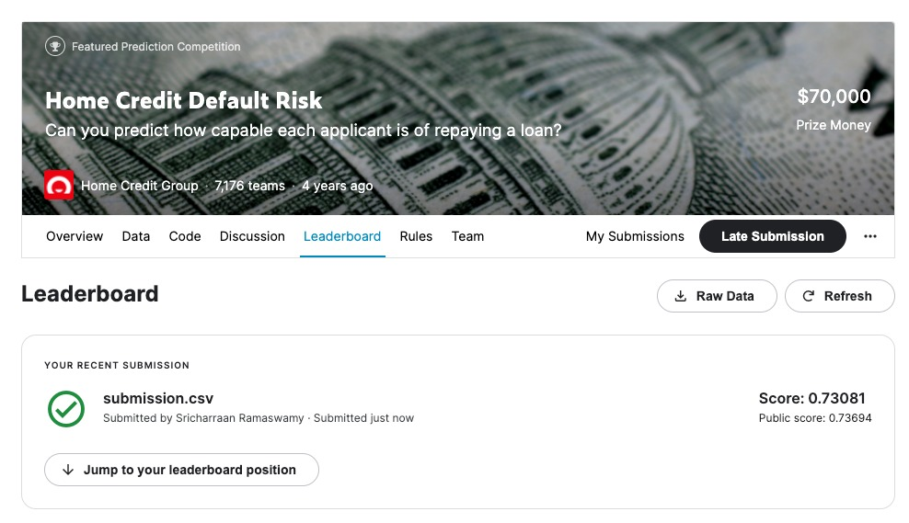
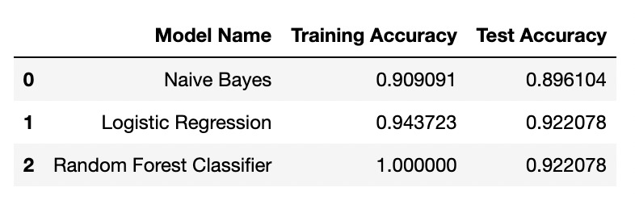
4 P’s – Past, Present, Proposed, Problems
Conclusion and Results
PAST: We cleaned the data and selected only the features that were relevant to the prediction and target variable. We highlighted data that was performing OHE and used imputing methods to clean it up before feeding it to the model. We were able to build a baseline process and grasp the accuracies of models like logistic regression, naïve bayes, and Random forest through experimentation. Based on the findings of the models, we discovered that naive bayes may be underfitting while Random Forest may be overfitting. Logistic Regression was the best model we could find for Phase 0, with a training accuracy of 91.9 percent and a Kaggle submission accuracy of 73.6 percent.
PRESENT: The entire dataset was merged, and necessary features were extracted and cleaned the data to find the most relevant features to the target variable and prediction
We created our own features from the most correlated features which contributed towards the prediction.
We performed hyperparameter tuning for our models alongside using K-Fold cross validation and GridSearchCV. Thus, mentioned steps contributed to improve the test accuracy as the model used best parameters for prediction.
PROPOSED: Our next plan is to apply Deep Learning techniques like developing Artificial Neural Networks for better prediction results.
PROBLEMS: Cleaning the large data

